Slide 1
Cache Mapping
In computer memory management, there are three main types of cache mapping techniques: Direct Mapping, Associative Mapping, and Set-Associative Mapping.
In Direct Mapping, each block from main memory has only one possible place in the cache organization. This technique is simpler and cheaper but can result in conflict misses when two different addresses correspond to one entry in the cache.
In Associative Mapping, also known as fully associative cache mapping, the mapping of the main memory block can be done with any of the cache blocks. This technique is more complex and allows for greater flexibility in storing addresses but requires more comparators and transistors to check all current entries.
Set-Associative Mapping combines both Direct and Associative Mapping techniques. A cache is divided into sets, and each set consists of "ways". Sets are directly mapped, and within themselves are fully associative. This technique solves the problem of temporal locality and is not as complex as fully associative mapping.

Slide 2
1. Direct Mapping
Description:
In direct mapping, each block of main memory maps to only one possible cache line. The mapping is done using a simple modulo operation where the memory block number is divided by the number of lines in the cache.
Advantages:
Simple and fast to implement because the cache location can be determined quickly using simple arithmetic.
Hardware implementation is relatively straightforward and inexpensive.
Disadvantages:
Can lead to high conflict misses because multiple memory blocks map to the same cache line.
Not as efficient in handling a variety of access patterns because any one cache line can only store one corresponding memory block at a time.

Slide 3
2. Associative Mapping (Fully Associative Mapping)
Description:
In associative mapping, any block of main memory can be loaded into any line of the cache. The decision is typically based on the availability of cache lines or using a replacement algorithm like LRU (Least Recently Used).
Advantages:
Highly flexible, allowing any memory block to be stored in any cache line, which minimizes conflict misses.
Best suited for applications with irregular access patterns where conflict misses significantly degrade performance.
Disadvantages:
More complex to implement because it requires more complex hardware to search the entire cache to check if a block is in the cache.
Typically, slower and more expensive due to the need for additional hardware for the searching mechanism.

Slide 4
3. Set-Associative Mapping
Description:
This technique is a hybrid of direct and associative mapping. The cache is divided into several sets, and each set contains multiple lines. A given block of main memory can be placed in any line within a specific set, determined usually by some bits of the address.
Advantages:
Reduces the likelihood of conflict misses compared to direct mapping because each set acts like a mini cache where blocks can be flexibly placed.
Easier to implement than fully associative mapping while still offering better flexibility and hit rate than direct mapping.
Disadvantages:
More complex than direct mapping, though less so than fully associative.
Depending on the size and number of sets, it can still suffer from conflict misses if many memory blocks map to the same set.

Slide 5
Summary
Direct Mapping is simple and fast but suffers from high conflict misses.
Associative Mapping offers the greatest flexibility and lowest conflict misses but is costly and complex.
Set-Associative Mapping strikes a balance between complexity, cost, and performance, making it a popular choice in many modern cache architectures.
Choosing the right mapping technique depends on the specific requirements of the system, including the expected access pattern, the available hardware resources, and performance goals.
More info:
Direct memory mapping cache
https://www.youtube.com/watch?v=V_QS1HzJ8Bc
https://www.youtube.com/watch?v=OxaYvJquPe0
Associative mapping cache
https://www.youtube.com/watch?v=uwnsMaH-iV0
https://www.youtube.com/watch?v=OGDEsD3hdbk
Set associative cache
https://www.youtube.com/watch?v=KhAh6thw_TI
https://www.youtube.com/watch?v=ejTCm7eHsM8

Slide 6
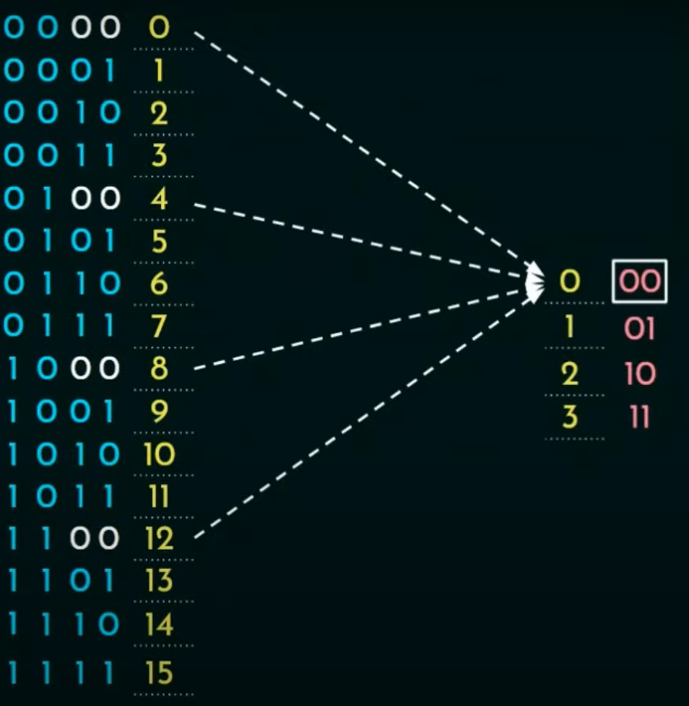
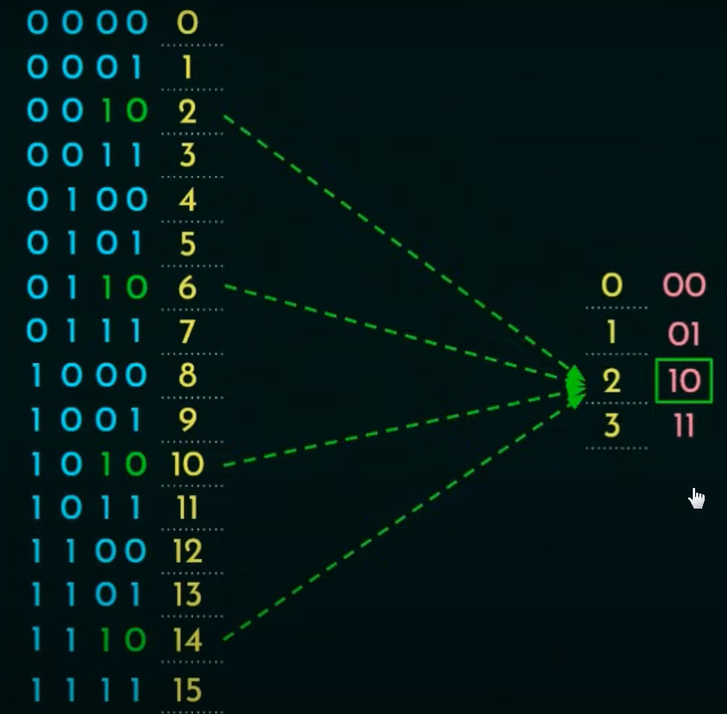
Direct Mapping
Notes:
Direct mapping

Slide 7
Direct Mapping
Memory address |  | 1 byte
0 | 0000
1 | 0001
2 | 0010
3 | 0011
4 | 0100
5 | 0101
6 | 0110
7 | 0111
8 | 1000
9 | 1001
10 | 1010
11 | 1011
12 | 1100
13 | 1101
14 | 1110
15 | 1111
Block Word = 2 bytes
Cache line
000 | 0
001 | 1
010 | 2
011 | 3
100 | 4
101 | 5
110 | 6
111 | 7
00
01
10
11
00
01
10
11
3 MSB
2 LSB

Slide 8
Direct Mapping
Memory address |  | 1 byte | Block |  | Cache line
0 | 0000 |  | 000 | 0 | 00
1 | 0001
2 | 0010 |  | 001 | 1 | 01
3 | 0011
4 | 0100 |  | 010 | 2 | 10
5 | 0101
6 | 0110 |  | 011 | 3 | 11
7 | 0111
8 | 1000 |  | 100 | 4 | 00
9 | 1001
10 | 1010 |  | 101 | 5 | 01
11 | 1011
12 | 1100 |  | 110 | 6 | 10
13 | 1101
14 | 1110 |  | 111 | 7 | 11
15 | 1111
DIFFERENT BLOCKS…
... SHARING SAME CACHE LINE.
3 MSB
2 LSB

Slide 9
Direct Mapping
Memory
Memory address |  | 1 byte | Block |  | Cache line
0 | 0000 |  | 000 | 0 | 00
1 | 0001
2 | 0010 |  | 001 | 1 | 01
3 | 0011
4 | 0100 |  | 010 | 2 | 10
5 | 0101
6 | 0110 |  | 011 | 3 | 11
7 | 0111
8 | 1000 |  | 100 | 4 | 00
9 | 1001
10 | 1010 |  | 101 | 5 | 01
11 | 1011
12 | 1100 |  | 110 | 6 | 10
13 | 1101
14 | 1110 |  | 111 | 7 | 11
15 | 1111
Cache
Line Number | Tag bits | Blocks Length = 2 Offset 0 | Offset 1
00
01
10
11
1 MSB
(block length = 2 need just 1 bit)
four lines (m=4)
two words/line (K =2)
memory 16 positions => 4 bit addresses (n=4)
eight blocks in memory (M =8)
3 MSB
2 LSB

Slide 10
Direct Mapping
The address is broken into three parts
Direct mapping is simple and inexpensive to implement, but if a program accesses 2 blocks that map to the same line repeatedly, the cache begins to trash back and forth reloading the line over and over again meaning misses are very high. https://faculty.etsu.edu/tarnoff/labs4717/x86_sim/direct.html

Slide 11
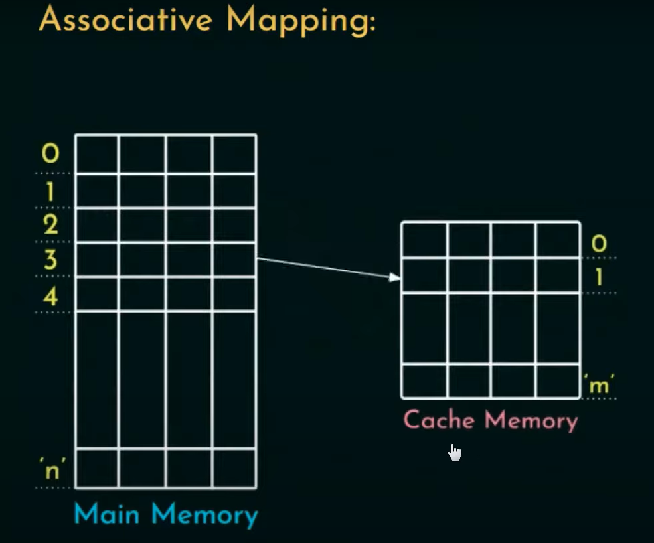
Any block can be assigned to any cache line. We need to check the tag…

Slide 12
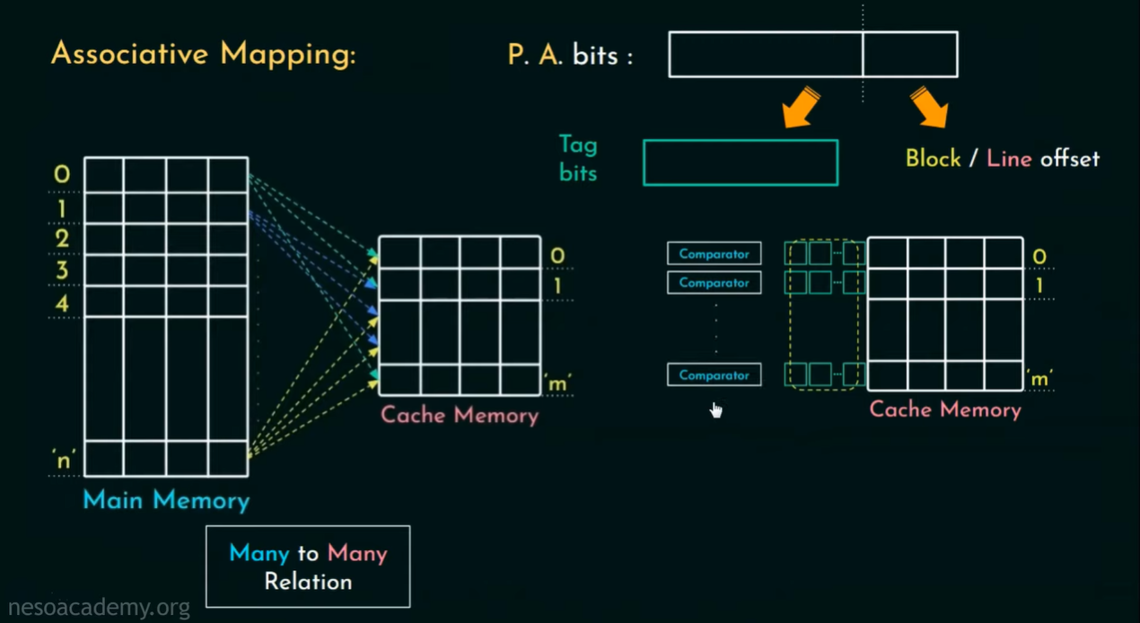

Slide 13
